Slide 1
Runtime analysis with Valgrind and Google Sanitizers
Tom Peters, August 22, 2018
thomas.d.peters@gmail.com
tdp2110 on slack, github

Slide 2
Outline
Disclaimer: this talk will be Linux-heavy.
Valgrind and valgrind tools (mostly memcheck)
Sanitizers (asan, msan, tsan, ubsan)
Practical recommendations
Notes:
And most of the code you will see is buggy. Some of the tools run on Mac and iOS, but not all of them. I'm not aware of any support on Windows.
We're going to talk about dynamic, aka, runtime analysis, which refers to catching bugs as they happen at runtime.
If you came to our Undefined Behavior talk and left feeling a bit depressed, this talk is meant to give you some hope. There are tools we can use to fight to nasal daemons!

Slide 3
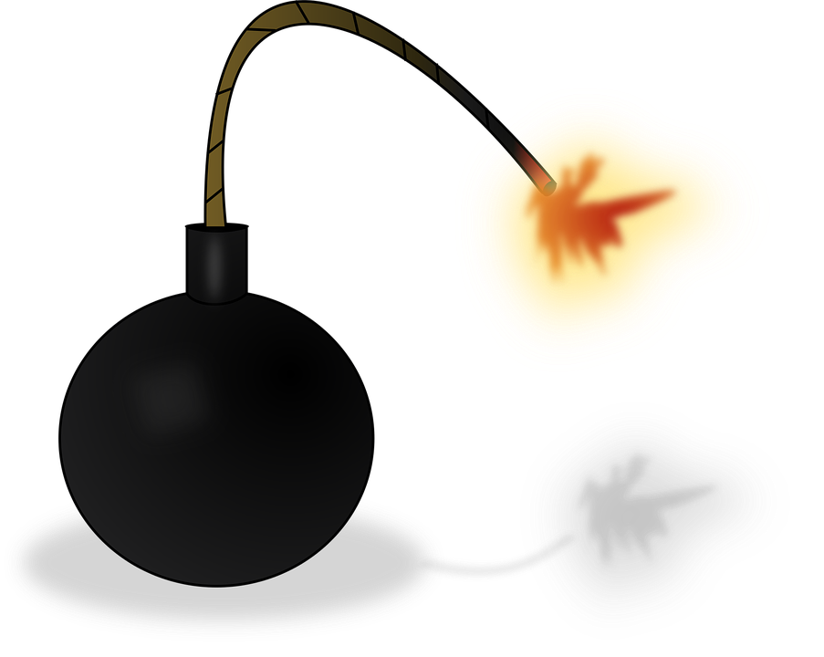
Remember: C++ is dangerous
Null pointer dereference
Signed integer overflow
Shifting beyond width
Array access out of bounds
Modification of a const object
Integer division by zero
Data races
Reaching end of value-returning function (other than main) without returning
Strict aliasing violations
ODR violation
… (the list goes on and on)
Notes:
C++ has extreme unsafety in it, mostly due to the presence of undefined behavior.
So-called "modern" C++ helps with a lot of this, but not all (signed integer overflow, for example, but there are libraries to help with that). It also brings problems of its own: ever heard of string_view? Or Span?
Why do we care? Obviously we don't want our software to crash, or worse our airplanes to crash, but many security vulnerabilities have their roots in erroneous C or C++ programs, for example the Morris worm. I believe there will be quite a few talks at this year's CppCon about security (including how UB can lead to remote code execution).
Fortunately, beyond programmer discipline and experience, we have tools to fight these problems, including ...

Slide 4
Tools to fight Undefined Behavior
Runtime (aka dynamic) analysis
Refers to catching bugs as they happen in an application
Static analysis
Looks for bugs "without executing the program"
Notes:
We'll talk about dynamic analysis today. There are tools to "mitigate" security holes (eg shut down a program when it's about to do something illegal). Today's tools will not be mitigation tools.
Last summer John gave a great talk on static analysis with CodeSonar. Even if you think you've never used a static analyzer before, in truth you have: compiler warnings are exactly static analysis

Slide 5
Why dynamic analysis
Catch real bugs as they happen in the wild.
Weaknesses of static analysis
Big difference between free and proprietary tools
Proprietary tools are expensive
Sometimes hard to use (or at least need hand-holding)
Human problem: often easy to ignore.
Weaknesses of dynamic analysis
You must hit the bug. (a symptom of being "unsound")
Sometimes "too late": compiler may have,eg, deleted code.
Notes:
I want to give a quick comparison between static and dynamic analysis
Dynamic analysis is Hard to ignore: a programmer might say, yeah ok, this could theoretically happen, but I'm too busy. Eg, compiler warnings are a basic form of static analysis. They might warn about a narrowing conversion. You might say, yeah ok, but I'm pretty sure this doesn't happen in my use case. It's harder to ignore when you get a concrete example from dynamic analysis (static analysis, in particular symbolic execution, can also give concrete examples)
And really I'm not saying either approach (static or dynamic) is better: they different tools working on the same problem, from sort of different directions. In reality, I'd argue you should use both if you can, and these tools complement each other nicely, and in the future can probably help each other out quite a bit. We'll talk about examples later of how static analysis can help improve dynamic analysis.
Use static analysis if you can

Slide 6
Valgrind (http://valgrind.org/)
A framework for dynamic binary instrumentation.
"Tools" use the framework to do something interesting with a binary.
Existing Valgrind tools:
Memcheck: a memory checker.
Cachegrind: a CPU cache profiler. It simulates instruction cache, and data caches.
Callgrind: extension of cachegrind to include call tree information
Massif: heap profiler
Helgrind: a thread debugger
Notes:
Let's talk about Valgrind. Valgrind is a framework for dynamic binary instrumentation: this means modifying code (binaries) at runtime to do something else (it's not the only such framework, eg, Pin, DynamoRIO). Valgrind is written in C, and the framework code is called valgrind-core, and it's responsible for binary translation, and handing chunks of code off to "tools", which "instrument" the code. Valgrind ships with several tools, including
memcheck is the most famous tool, and often when people say Valgrind, they really mean memcheck. We'll talk much more about Valgrind tonight.
Callgrind: extension of cachegrind, which includes extremely accurate call graph information (in contrast to sampling profilers).
Separately available is a great visualizer, KCachegrind, which visually shows call trees, and can be used with other profilers.
Valgrind-core, and all of these tools are written in C. It's possible to write your own tools. Valgrind only uses kernel headers, not even libc

Slide 7
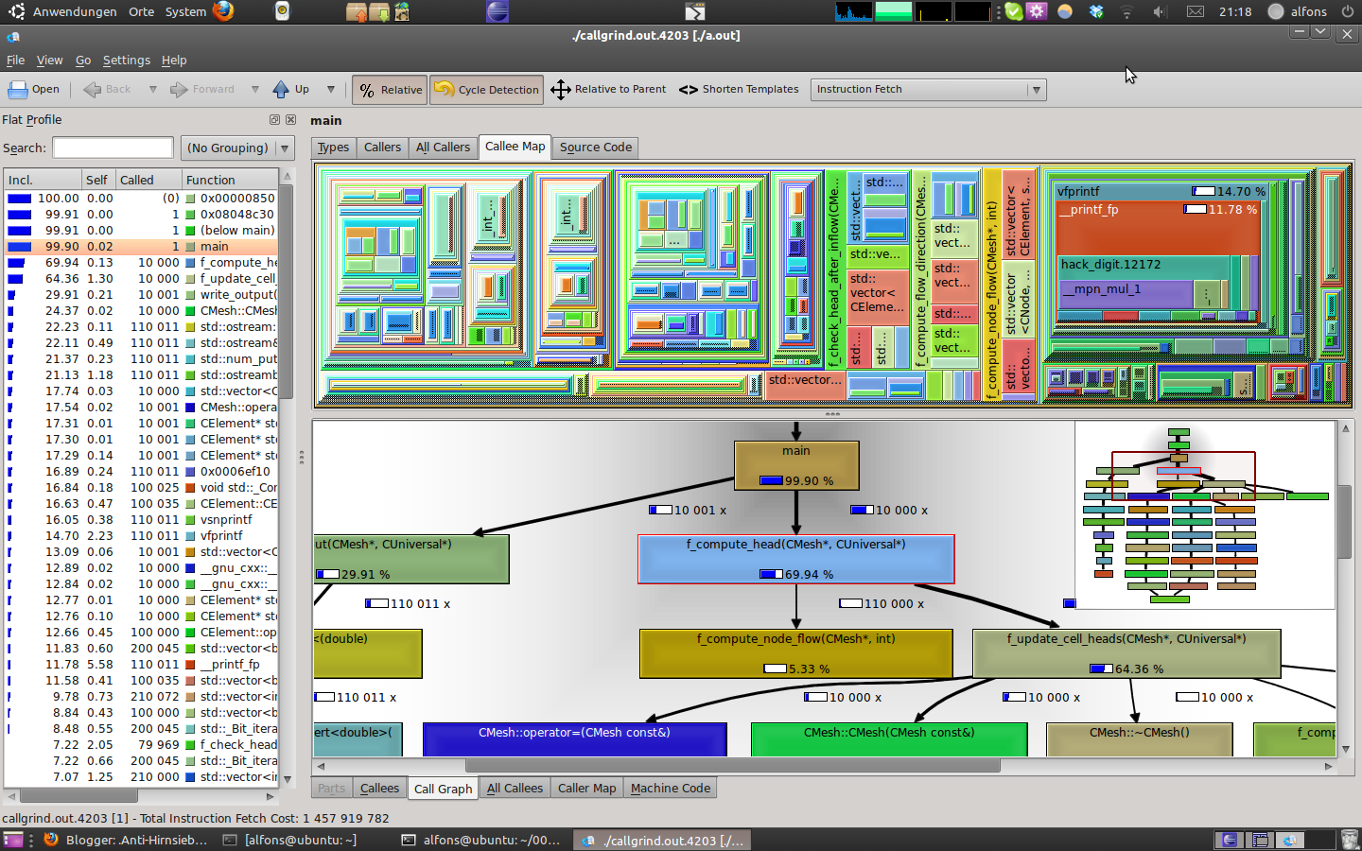
kcachegrind

Slide 8
Memcheck
Memory checker built off valgrind-core
Addressability - heap-buffer overflow, use after free, access beyond the top of the stack
(bitwise) Validity - use of uninitialized memory (sometimes with bit-precision)
Heap bookkeeping: Memory leaks, mismatched new[]/delete, double free
Other goodies: Detection of overlapping arguments to memcpy
Notes:
Valgrind basically does 3 things: heap bookkeeping, bitwise validity, addressability
Memcheck came out before Valgrind was a generic binary instrumentation framework. Only later did they separate out that logic to make it extensible.
Of addressability and validity, which do you think is harder to keep track of?

Slide 9


memcheck
"Keeping with the Nordic theme, Valgrind was chosen. Valgrind is the name of the main entrance to Valhalla (the Hall of the Chosen Slain in Asgard). Over this entrance there resides a wolf and over it there is the head of a boar and on it perches a huge eagle, whose eyes can see to the far regions of the nine worlds. Only those judged worthy by the guardians are allowed to pass through Valgrind. All others are refused entrance." Julian Seward (worked on GHC, works at Mozilla) Nicholas Nethercote (now works at Mozilla) First release 2002, worked on to this day
Notes:
Seward did an incredible service with valgrind and making it available for free and open source.
It was a game changer when it came out, and fixed an incredible number of bugs. Linux command-line tools were found to be quite dirty, but are now mostly clean.

Slide 10
Memcheck Demo
Notes:
So besides heap checking, valgrind has two main tasks: addressability and validity. Which of these do you think is harder? The answer, by far, is validity. We'll see why later.
Let's write some really terrible code here. Notice we didn't need to recompile or relink, we just invoke valgrind on an executable.

Slide 11
Memcheck Supported platforms
x86/Linux: up to and including SSSE3, but not higher -- no SSE4, AVX, AVX2. This target is in maintenance mode now..
AMD64/Linux: up to and including AVX2. This is the primary development target and tends to be well supported.
PPC32/Linux, PPC64/Linux, PPC64LE/Linux: up to and including Power8.
S390X/Linux: supported.
ARM/Linux: supported since ARMv7.
ARM64/Linux: supported for ARMv8.
MIPS32/Linux, MIPS64/Linux: supported.
X86/Solaris, AMD64/Solaris, X86/illumos, AMD64/illumos: supported since Solaris 11.
X86/Darwin (10.10, 10.11), AMD64/Darwin (10.10, 10.11): supported.
ARM/Android, ARM64/Android, MIPS32/Android, X86/Android: supported.

Slide 12
Valgrind Core
Executes client ("guest") code indirectly in a sort of VM
ThreadState data structure holds client registers (and "shadow" registers)
Disassembles chunks of client binary into intermediate representation (IR)
Disassembled code pulls guest registers from ThreadState
IR is passed to tools (such as memcheck), which modify it to do something else
Instrumented IR is optimized, JITted, and then executes it.
Maintains code cache, finds, creates, and executes translations.
Thread safe, but has a global interpreter lock
Notes:
Tour of valgrind core. Instead of directly running application binaries, Valgrind disassembles small chunks of them into a platform independent SSA RISC intermediate representation (IR) (currently called VEX). This disassembly includes code to pull guest registers from the ThreadState at the start of the block, and code to write them back at the end of the block. In between, the original instructions of the binary are translated. These chunks of IR are passed to tools, which instrument (in other words modify) the code. Valgrind then JITs the IR (ie compiles to machine code), and runs it. Valgrind maintains a code cache, and spends most of its time searching for and making translations.
Valgrind itself runs on the machine’s real or host CPU, and (conceptually) runs the client program on a simulated or guest CPU. We refer to registers in the host CPU as host registers and those of the simulated CPU as guest registers. Due to the dynamic binary recompilation process, a guest register’s value may reside in one of the host’s registers, or it may be spilled to memory for a variety of reasons. Shadow registers are shadows of guest registers.
Valgrind provides a block of memory per client thread called the ThreadState. Each one contains space for all the thread’s guest and shadow registers and is used to hold them at various times, in particular between each code block. Storing guest registers in memory between code blocks sounds like a bad idea at first, because it means that they must be moved between memory and the host registers frequently, but it is reasonable for heavyweight tools with high host register pressure. There is no first class support for shadow memory

Slide 13
Valgrind core
Valgrind uses "disassemble and resynthesize" (D&R)
Other DBI frameworks use "copy and annotate"
Notes:
This approach for binary translation is called D&R: disassemble and resynthesize, in contrast to copy and annotate. Copy and annotate is simpler and is more useful for simple instrumentation, eg profilers. But for heavyweight tools, such as memcheck, D&R is much more powerful:
Tools can do complicated complications without having to worry about how many registers are available
Analysis and client code can be simultaneously optimized

Slide 14
Translation phases
Disassembly*: machine code → tree IR.
Optimization 1: tree IR → flat IR.
Instrumentation: flat IR → flat IR.
Optimization 2: flat IR → flat IR.
Tree building: flat IR → tree IR.
Instruction selection*: tree IR → instruction list.
Register allocation: instruction list → instruction list.

Slide 15
example: machine code → tree IR
0x24F275: movl -16180(%ebx,%eax,4),%eax 1: ------ IMark(0x24F275, 7) ------ 2: t0 = Add32(Add32(GET:I32(12), # get %ebx and Shl32(GET:I32(0),0x2:I8)), # %eax, and 0xFFFFC0CC:I32) # compute addr 3: PUT(0) = LDle:I32(t0) # put %eax 0x24F27C: addl %ebx,%eax 4: ------ IMark(0x24F27C, 2) ------ 5: PUT(60) = 0x24F27C:I32 # put %eip 6: t3 = GET:I32(0) # get %eax 7: t2 = GET:I32(12) # get %ebx 8: t1 = Add32(t3,t2) # addl 9: PUT(32) = 0x3:I32 # put eflags val1 10: PUT(36) = t3 # put eflags val2 11: PUT(40) = t2 # put eflags val3 12: PUT(44) = 0x0:I32 # put eflags val4 13: PUT(0) = t1 # put %eax | 0x24F27E: jmp*l %eax 14: ------ IMark(0x24F27E, 2) ------ 15: PUT(60) = 0x24F27E:I32 # put %eip 16: t4 = GET:I32(0) # get %eax 17: goto {Boring} t4

Slide 16
memcheck-instrumented, flat IR
0x24F275: movl -16180(%ebx,%eax,4),%eax * 1: ------ IMark(0x24F275, 7) ------ 2: t11 = GET:I32(320) # get sh(%eax) * 3: t8 = GET:I32(0) # *get %eax 4: t14 = Shl32(t11,0x2:I8) # shadow shll * 5: t7 = Shl32(t8,0x2:I8) # *shll 6: t18 = GET:I32(332) # get sh(%ebx) * 7: t9 = GET:I32(12) # *get %ebx 8: t19 = Or32(t18,t14) # shadow addl 1/3 9: t20 = Neg32(t19) # shadow addl 2/3 10: t21 = Or32(t19,t20) # shadow addl 3/3 *11: t6 = Add32(t9,t7) # *addl 12: t24 = Neg32(t21) # shadow addl 1/2 13: t25 = Or32(t21,t24) # shadow addl 2/2 *14: t5 = Add32(t6,0xFFFFC0CC:I32) # *addl 15: t27 = CmpNEZ32(t25) # shadow loadl 1/3 | 16: DIRTY t27 RdFX-gst(16,4) RdFX-gst(60,4) ::: helperc_value_check4_fail{0x380035f4}() # shadow # loadl 2/3 17: t29 = DIRTY 1:I1 RdFX-gst(16,4) RdFX-gst(60,4) ::: helperc_LOADV32le{0x38006504}(t5) # shadow loadl 3/3 *18: t10 = LDle:I32(t5) # *loadl
Notes:
15 tests definedness of pointer by comparing its shadow value to zero
16 conditional call to error reporting function
DIRTY and RdFX indicate that some guest registers are read from ThreadState, and must be up-to-date
17 calls another C function which does a shadow load to complement the original load on line 18

Slide 17
Memcheck: validity (aka, bitwise definedness)
When to flag use of uninitialized memory an error?
C++ standard [13, sec 4.1, p1]: any lvalue-to-rvalue conversion on an uninitialized object has undefined behavior (C++14 relaxed for byte types).
Valgrind works with bytes, padding causes a problem
eg, struct Foo { char c, int32_t i };
Only operations which affect "observable" behavior are flagged as errors:
Control flow transfers
Conditional moves
Addresses used for memory access
Parameters to system calls
Notes:
Ask the audience: how do we know when accessing uninitialized memory is an error?
You could flag all reads of uninit mem, but that would give false positives.

Slide 18
Memcheck: shadow memory
For each byte of application memory, keep track of:
One A bit: 0 means unaddressable, 1 means addressable.
8 V bits: tracks bitwise definedness
=> need (up to) 257 bits per application bytes to track both.
Stored in something like a page table: address space is divided into 64K chunks. Each chunk is associated a "secondary map" (assume 32-bit address space):
typedef struct {
uint8_t abits[8192];
uint8_t vbits[65536];
} SM;
SM* PM[65536]; // "Primary map": covers 4GB
Notes:
Let's talk about how memcheck does its thing. Memcheck works by keeping shadow memory: for each byte of application memory, memcheck keeps some separate "shadow" memory which keeps track of addressability and validity.
Suppose we have a 32-bit address space. Maintain something like a page table: a two-level mapping. High 16 bits give the index into the primary module, and low 16 bits give the indexes for abits and vbits.

Slide 19
Instrumenting loads
U64 LOADVn(Addr a, SizeT nBits) {
U1 abit; U8 vbits8; Int i;
U64 vbits64 = V_BITS64_UNDEFINED;
SizeT n_bad_addrs = 0;
for (i = 0; i < nBits / 8; i++) {
get_abit_and_vbits8(&abit, &vbits8, a + i);
if (abit != A_BIT_ADDRESSABLE) {
n_bad_addrs++; // Defined-if
vbits8 = V_BITS8_DEFINED; // unaddressable
}
vbits64 = (vbits64 << 8) | vbits8;
}
if (n_bad_addrs > 0)
record_address_error(a, nBits);
return vbits64;
}
Application loads are preceded by shadow loads.
Notes:
And there's something similar for stores

Slide 20
Optimizations:
Aligned loads can be done without a loop
Vectorized range-setting
Distinguished SMs: NOACCESS, DEFINED, UNDEFINED.
Compressed V-bits: instead of 9 bits per byte, just use two, gives 4 states:
(1. Not addressable: NOACCESS), (2. addressable and completely defined: DEFINED), (3. addressable and completely undefined: UNDEFINED), (4. addressable and partially defined, PARTDEFINED)
Faster stack updates.
Notes:
So actually I lied to you. What I just described is conceptually how memcheck shadows memory, but in reality it uses a variety of optimizations.
Large code and data sections can use DEFINED, because code segments are rarely written to.
Partially defined bytes (PDBs) require a secondary lookup

Slide 21
Memcheck: malloc replacement
Poisoned redzones flank heap-blocks
Stacktraces written to heap-blocks in redzones
Delays reuse of heap-blocks after free. Aka, "quarantine"

Slide 22
Memcheck: calculus of validity.
Let d1, d2 denote virtual registers, v1, v2 their corresponding shadow registers.
What are validity bits of, eg, d1 + d2?
Notes:
Let's talk about keeping track of bitwise validity.

Slide 23
Memcheck: calculus of validity.
Let d1, d2 denote virtual registers, v1, v2 their corresponding shadow registers.
What are validity bits of, eg, d1 + d2?
UifU(v1, v2)? Undefined if either undefined?

Slide 24
Memcheck: calculus of validity.
Let d1, d2 denote virtual registers, v1, v2 their corresponding shadow registers.
What are validity bits of, eg, d1 + d2?
UifU(v1, v2)? Undefined if either undefined?
Left(UifU(v1, v2))? Overly pessimistic?
Notes:
Defined zeros stop carry propagation.
Valgrind defines a calculus on validity values, and it gets complicated really quickly. Some operations are tracked exactly, others are conservatively tracked.

Slide 25
Memcheck
Found innumerable bugs over the years
Still useful.
Slow. 20-40x slowdown for single-threaded performance
Notes:
I criticized static analysis for not being super user friendly, but valgrind has its own drawbacks: mostly speed.
In order to address this, Google developed products to perform similar functionality using compile time instrumentation.

Slide 26

Google sanitizers
AddressSanitizer (asan): addressability checks (A-bits)
MemorySanitizer (msan, memsan): bitwise validity (definedness) (V-bits)
ThreadSanitizer (tsan): data race detector
UndefinedBehaviorSanitizer (ubsan): various "simple" checks, eg, integer overflow
All use compile-time instrumentation of code.
Kostya Serebryany
Notes:
There are other sanitizers, for various forms of security mitigation, including CFI and Safe Stack, but we won't talk about them.
They all use compile-time instrumentation of code, which speeds them up enormously compared to valgrind tools

Slide 27
Quick tour of clang/llvm
C
Clang
LLVM
C++
Clang AST
LLVM-IR
Optimization
passes
ObjC/C++
CodeGen
Rust
Swift
Others
https://github.com/llvm-mirror/clang
https://github.com/llvm-mirror/llvm
Machine Code (x86, ARM, PPC, …)
Notes:
Both of these projects are implemented with high-quality C++ code. If you're curious to see how compilers work, I'd encourage you to take a look at these projects.
Most of the sanitizers work at the LLVM-IR level, as optimization passes, late in the optimization pipeline (which means quite a bit of source information is lost, and they are already susceptible to UB-based optimizations). Of the sanitizers I mentioned, only UBSan works at a different level: at the clang-AST level
https://github.com/llvm-mirror/clang
https://github.com/llvm-mirror/llvm

Slide 28
AddressSanitizer
Out-of-bounds accesses to heap, stack and globals
Use-after-free
Stack use-after-return (runtime flag ASAN_OPTIONS=detect_stack_use_after_return=1)
Use-after-scope (clang flag -fsanitize-address-use-after-scope)
Double-free, invalid free
Memory leaks (experimental)
STL container over/underflow (!)
2-4x slowdown!
Notes:
Similar to addressability checking in memcheck, but inserts redzones around globals and stack objects too (which memcheck does not). Memcheck is able to detect some accesses beyond the top of the stack, but nothing else. It uses a very similar approach as valgrind (shadow memory, malloc replacement, poisoned redzones, delayed reuse of freed heap blocks).
Use after scope effectively creates moves variables to the heap.
By default, asan aborts the process on error, providing a nice error message. Let's look at one.
Asan is an order of magnitude faster than memcheck, since all instrumentation is inserted at compile time. It also uses a few other tricks ...

Slide 29
AddressSanitizer demo

Slide 30
AddressSanitizer
Observation: addresses returned by malloc are typically (at least) 8-byte aligned (why?)
=> Each aligned 8-byte sequence of application heap memory is in one of 9 states: first k (0 <= k <= 8) bytes are addressable, remaining 8 - k bytes are not
=> Addressability of each aligned 8-byte sequence of application heap memory can be encoded by a single byte. 0 means completely addressible, k (0 <= k <= 8) means first k bytes are addressable, negatives distinguish between different unaddressable states (heap redzones, stack redzones, global redzones, …)

Slide 31
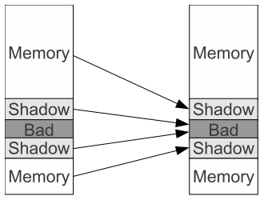
Asan Shadow mapping: shadow(Addr) = (Addr >> 3) + Offset;
32-bit systems:
Offset = 2**29
64-bit systems:
Offset = 2 ** 44

Slide 32
Asan Instrumentation
Implemented in https://github.com/llvm-mirror/llvm/blob/master/lib/Transforms/Instrumentation/AddressSanitizer.cpp
// 8 byte loads
ShadowAddr = (Addr >> 3) + Offset;
if (*ShadowAddr != 0)
ReportAndCrash(Addr);
// 1-,2-, or 4-byte accesses
ShadowAddr = (Addr >> 3) + Offset;
k = *ShadowAddr;
if (k != 0 && ((Addr & 7) + AccessSize) > k)
ReportAndCrash(Addr);
Notes:
Unlike memcheck, asan inserts only one memory read for each memory access in the original code.
Asan assumes N-byte loads are aligned to N.
As mentioned, asan is implemented as a late compiler optimization pass. Mem accesses to local stack objects optimized out by LLVM are not instrumented. Also don't have to instrument memory accesses created by codegen (eg, register spills)
Asan is thread safe, assuming LLVM follows the C++ memory model.

Slide 33
Asan Runtime Library
https://github.com/llvm-mirror/compiler-rt/tree/master/lib/asan
libasan.{so|dylib}
Malloc replacement
Redzone insertion
Free quarantine
Global redzone initialization
Error reporting
Notes:
This is the meat of the project.
The compiler instrumentation is comparatively simple, and is only about 3000 lines. GCC implemented similar instrumentation too.

Slide 34
Asan, memcheck comparison
Asan wins:
Speed
Instrumentation of globals, better stack instrumentation, use after return, container overflow
Memcheck wins:
Also checks (bitwise) validity
Inline assembly, jitted code, external libs handled
Requires no compilation, linking changes.

Slide 35
MemorySanitizer
Detector of uninitialized memory reads (UMR) in C/C++.
Similar to validity checking in valgrind.
(bitwise) Validity calculus is less precise than Valgrind
https://github.com/llvm-mirror/llvm/blob/master/lib/Transforms/Instrumentation/MemorySanitizer.cpp
https://github.com/llvm-mirror/compiler-rt/tree/master/lib/msan
Notes:
Similar approach to asan: compiler instrumentation is implemented in LLVM, and a runtime library (which includes malloc replacement, and origin tracking)
NOT implemented in GCC, or apple-clang

Slide 36
Memsan example
% cat umr2.cc #include <stdio.h> int main(int argc, char** argv) { int* a = new int[10]; a[5] = 0; volatile int b = a[argc]; if (b) printf("xx\n"); return 0; } % clang -fsanitize=memory \ -fsanitize-memory-track-origins=2 \ -fno-omit-frame-pointer -g -O2 \ umr2.cc | % ./a.out WARNING: MemorySanitizer: use-of-uninitialized-value #0 0x7f7893912f0b in main umr2.cc:7 #1 0x7f789249b76c in __libc_start_main libc-start.c:226 Uninitialized value was stored to memory at #0 0x7f78938b5c25 in __msan_chain_origin msan.cc:484 #1 0x7f7893912ecd in main umr2.cc:6 Uninitialized value was created by a heap allocation #0 0x7f7893901cbd in operator new[](unsigned long) msan_new_delete.cc:44 #1 0x7f7893912e06 in main umr2.cc:4

Slide 37
Memsan, memcheck comparison
Memsan wins:
Speed
Better origin tracking, knows variable names
Memcheck wins:
Also checks addressability
Inline assembly, jitted code, shared libs all OK
Doesn't require all libs to be instrumented

Slide 38
ThreadSanitizer
Data race detector based on compile-time instrumentation.
Slowdown 5x-15x
Memory overhead 5x-10x

Slide 39
Tsan demo

Slide 40
Tsan shadow mapping
Shadow State is N Shadow Words (described below); N is one of 2, 4, 8 (configurable). Every aligned 8-byte word of application memory is mapped into N Shadow Words using direct address mapping. Shadow Word, a 64-bit object: TID (Thread Id): 16 bits (configurable) Scalar Clock: 42 bits (configurable) IsWrite: 1 bit Access Size (1, 2, 4 or 8): 2 bits Address Offset (0..7): 3 bits
One Shadow Word represents a single memory access to a subset of bytes within the 8-byte word of application memory. Therefore the Shadow State describes N different accesses to the corresponding application memory region.
Notes:
Tsan shadow memory keep track of events at each address. Runtime library keeps track of synchronization events, such as locks.
Accesses are checked for consistency: if a happens-before relationship cannot be proven, a warning is issued

Slide 41
UndefinedBehaviorSanitizer (1)
-fsanitize=alignment: Use of a misaligned pointer or creation of a misaligned reference.
-fsanitize=bool: Load of a bool value which is neither true nor false.
-fsanitize=builtin: Passing invalid values to compiler builtins.
-fsanitize=bounds: Out of bounds array indexing, in cases where the array bound can be statically determined.
-fsanitize=enum: Load of a value of an enumerated type which is not in the range of representable values for that enumerated type.
-fsanitize=float-cast-overflow: Conversion to, from, or between floating-point types which would overflow the destination.
-fsanitize=float-divide-by-zero: Floating point division by zero.
-fsanitize=function: Indirect call of a function through a function pointer of the wrong type (Darwin/Linux, C++ and x86/x86_64 only).
-fsanitize=implicit-integer-truncation: Implicit conversion from integer of larger bit width to smaller bit width, if that results in data loss. That is, if the demoted value, after casting back to the original width, is not equal to the original value before the downcast. Issues caught by this sanitizer are not undefined behavior, but are often unintentional.
-fsanitize=integer-divide-by-zero: Integer division by zero.
-fsanitize=nonnull-attribute: Passing null pointer as a function parameter which is declared to never be null.
-fsanitize=null: Use of a null pointer or creation of a null reference.
-fsanitize=nullability-arg: Passing null as a function parameter which is annotated with _Nonnull.
-fsanitize=nullability-assign: Assigning null to an lvalue which is annotated with _Nonnull.

Slide 42
Ubsan (2)
-fsanitize=nullability-return: Returning null from a function with a return type annotated with _Nonnull.
-fsanitize=object-size: An attempt to potentially use bytes which the optimizer can determine are not part of the object being accessed. This will also detect some types of undefined behavior that may not directly access memory, but are provably incorrect given the size of the objects involved, such as invalid downcasts and calling methods on invalid pointers. These checks are made in terms of __builtin_object_size, and consequently may be able to detect more problems at higher optimization levels.
-fsanitize=pointer-overflow: Performing pointer arithmetic which overflows.
-fsanitize=return: In C++, reaching the end of a value-returning function without returning a value.
-fsanitize=returns-nonnull-attribute: Returning null pointer from a function which is declared to never return null.
-fsanitize=shift: Shift operators where the amount shifted is greater or equal to the promoted bit-width of the left hand side or less than zero, or where the left hand side is negative. For a signed left shift, also checks for signed overflow in C, and for unsigned overflow in C++. You can use -fsanitize=shift-base or -fsanitize=shift-exponent to check only left-hand side or right-hand side of shift operation, respectively.
-fsanitize=signed-integer-overflow: Signed integer overflow, where the result of a signed integer computation cannot be represented in its type. This includes all the checks covered by -ftrapv, as well as checks for signed division overflow (INT_MIN/-1), but not checks for lossy implicit conversions performed before the computation (see -fsanitize=implicit-conversion). Both of these two issues are handled by -fsanitize=implicit-conversion group of checks.
-fsanitize=unreachable: If control flow reaches an unreachable program point.

Slide 43
Ubsan (3)
-fsanitize=unsigned-integer-overflow: Unsigned integer overflow, where the result of an unsigned integer computation cannot be represented in its type. Unlike signed integer overflow, this is not undefined behavior, but it is often unintentional. This sanitizer does not check for lossy implicit conversions performed before such a computation (see -fsanitize=implicit-conversion).
-fsanitize=vla-bound: A variable-length array whose bound does not evaluate to a positive value.
-fsanitize=vptr: Use of an object whose vptr indicates that it is of the wrong dynamic type, or that its lifetime has not begun or has ended. Incompatible with -fno-rtti. Link must be performed by clang++, not clang, to make sure C++-specific parts of the runtime library and C++ standard libraries are present.

Slide 44
Ubsan demo

Slide 45
Practical recommendations
Use these tools. (and static analysis too)
How should you take advantage of these tools?
Run them as necessary, much like debuggers.
Run them on your unit tests, eg nightly or weekly memory checks.
This is particularly easy for valgrind and cmake: ctest -T memcheck
For sanitizers, it requires multiple rebuilds (no two sanitizers which require shadow memory can be run simultaneously)
Run instrumented fuzz tests.
Notes:
There are libraries to help with fuzzing, such as llvm's libfuzzer, or AFL. the tricky thing is finding interesting inputs.
You may have heard of heartbleed from a few years ago. Libfuzzer can catch it in a few minutes without a fuzzing corpus.
Many projects use fuzzing, ex chrome, clang, and llvm

Slide 46
Csmith: generator of valid c99 programs
// an example csmith program which // at some point crashed clang typedef signed char int8_t; typedef short int int16_t; typedef int int32_t; typedef unsigned char uint8_t; typedef unsigned int uint32_t; uint32_t g_2 = 8L; volatile int16_t g_133 = 0x7EAAL; uint32_t g_139 = 0L; volatile uint8_t g_160 = 6L; int32_t func_31 (int16_t p_33, int16_t p_34, int32_t p_35); int32_t func_97 (uint32_t p_98); | int32_t func_97 (uint32_t p_98) { uint8_t l_190 = 0xFAL; int8_t l_163 = 1L; for (p_98 = -26; ((g_160) >= -29); (g_160)--) { int8_t l_192 = 0x85L; func_31 (((((l_190 / 1L) - p_98) ^ ((g_139 + p_98) ^ 0xA2D7L)) && g_2), (((((g_133) && l_192) || p_98) | l_163) > 1L), p_98); } }
Notes:
Deep learning combined with fuzzing seems like a great approach

Slide 47
Final points
Dynamic analysis and fuzzing have found thousands of bugs in Chrome
Despite this, "canaries" still find bugs that elude Google's best efforts
Most common addressability bug at Google: use after free, followed by heap buffer overflow.

Slide 48
References
Valgrind
http://valgrind.org/
Valgrind: a Framework for Heavyweight Dynamic Binary Instrumentation (http://valgrind.org/docs/valgrind2007.pdf)
Using Valgrind to detect undefined value errors with bit-precision (http://valgrind.org/docs/memcheck2005.pdf)
How to shadow every byte of memory used by a program (http://www-leland.stanford.edu/class/cs343/resources/shadow-memory2007.pdf)
AddressSanitizer
https://clang.llvm.org/docs/AddressSanitizer.html
https://www.usenix.org/system/files/conference/atc12/atc12-final39.pdf
MemorySanitizer
https://clang.llvm.org/docs/MemorySanitizer.html
https://static.googleusercontent.com/media/research.google.com/en//pubs/archive/43308.pdf
ThreadSanitizer
https://clang.llvm.org/docs/ThreadSanitizer.html
ThreadSanitizer – data race detection in practice (https://static.googleusercontent.com/media/research.google.com/en//pubs/archive/35604.pdf). Note: dated -- describes an old TSAN
Fuzzing
https://llvm.org/docs/LibFuzzer.html
http://lcamtuf.coredump.cx/afl/

